Slide 1
Advisor
to farmers

Slide 2
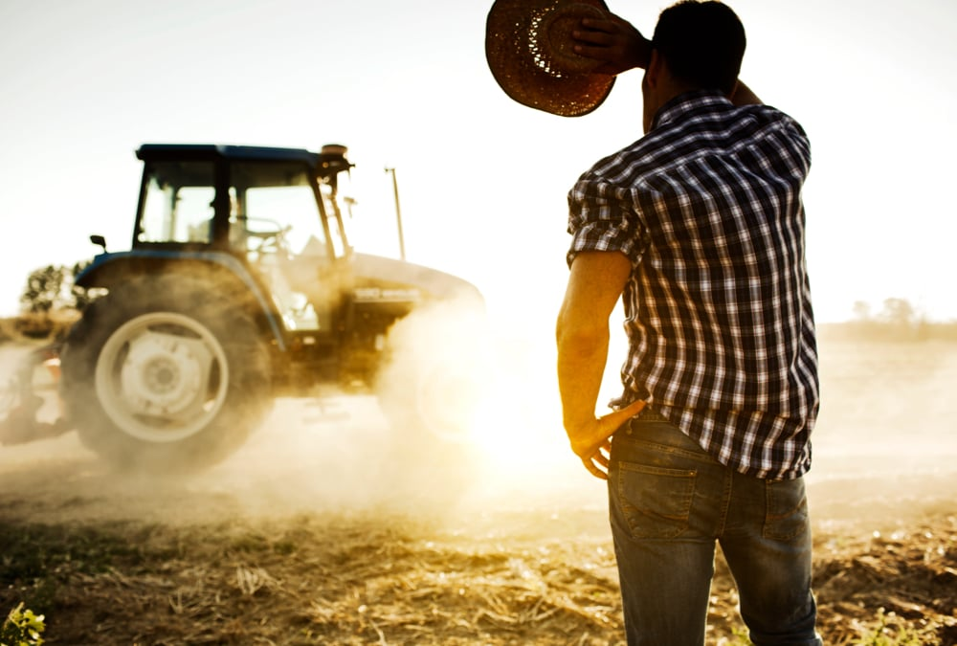
Problem
farmers are busy
mistakes can lead to waste of product and working time
agriculture advisory is expensive

Slide 3
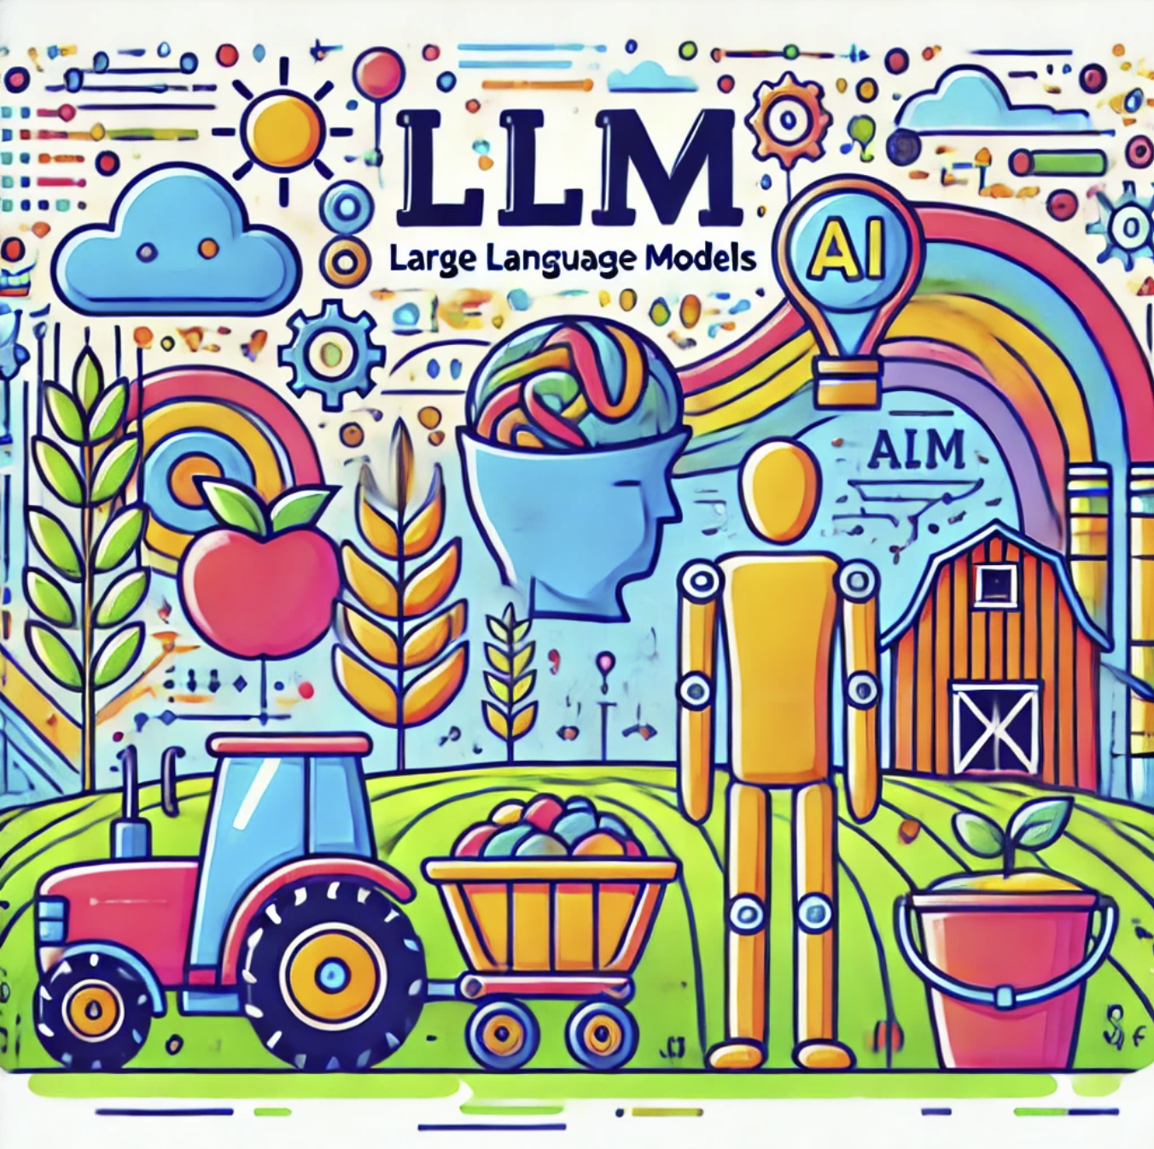
Solution
AI based advisor in a form of friendly dialog
utilizing
recent research
local nuances
farmer’s values

Slide 4
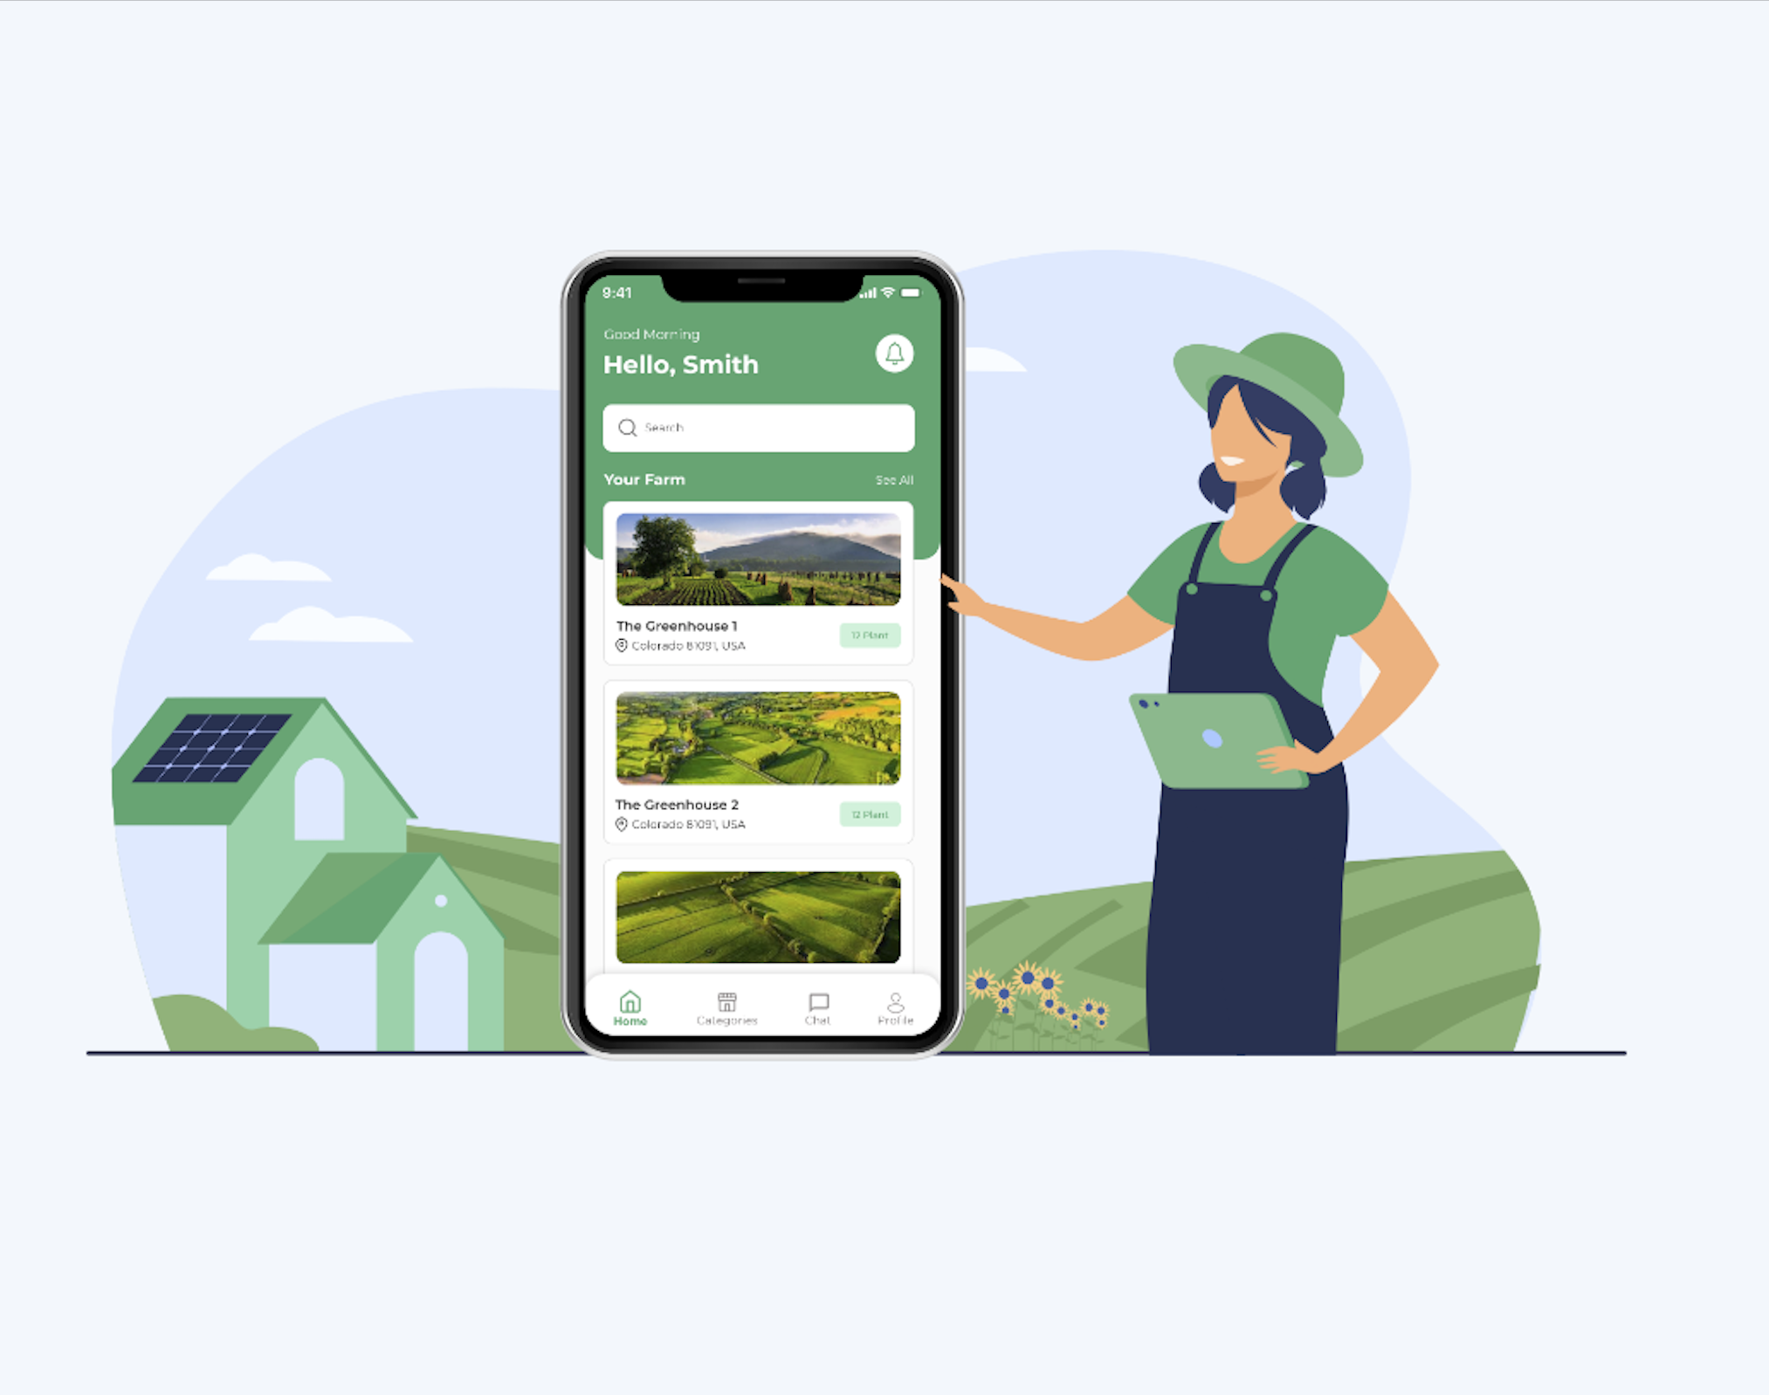
Monetization
Chat dialog in your mobile app with paid subscription

Slide 5
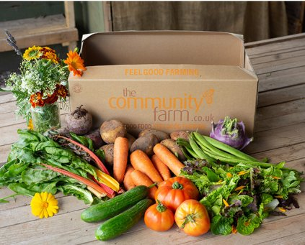
Benefits
easy to interact with
knowledge based decisions
high quality products
more food
better environment

Slide 6


Farmers say
If searching for the right advice takes more than 10 mins I give up
I had to throw away hay for horse because it got moldy

Slide 7
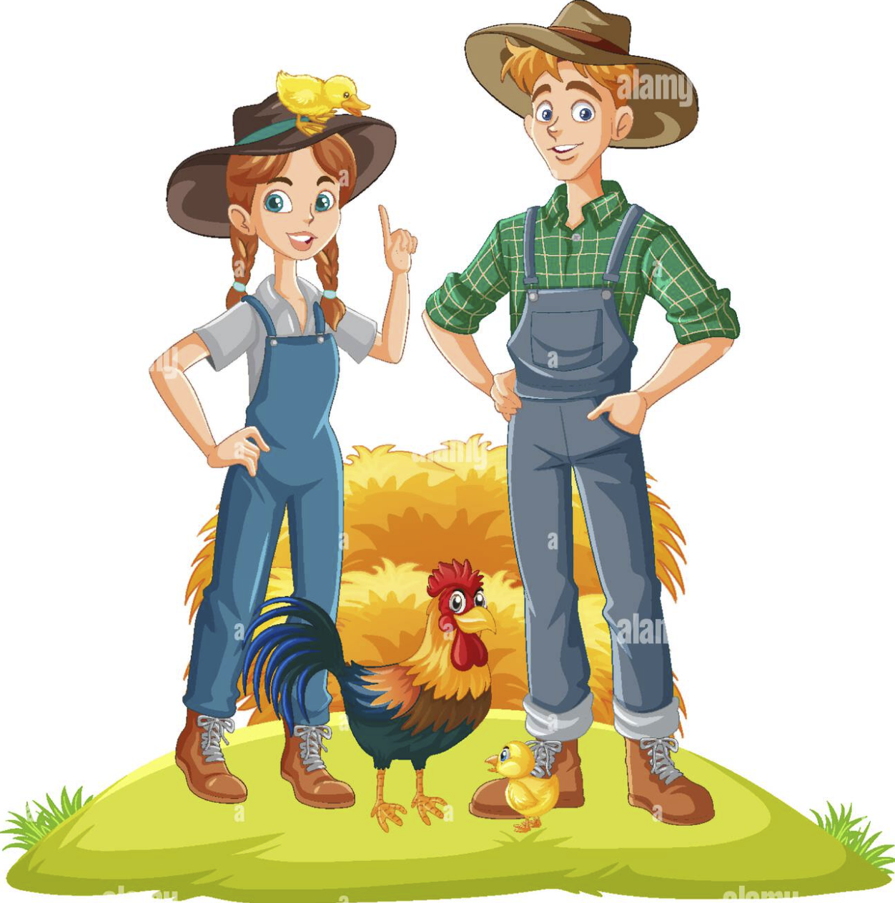
We are from Sweden and we bought a farm in Møre og Romsdal.
What should we know about local conditions?
If farmers don’t find the right solution for their problem they look what their neighbors do or learn from own mistakes.

Slide 8
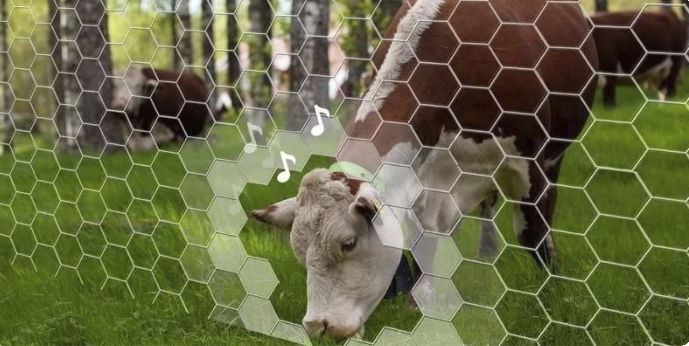
Organic paradox
Virtual fencing
From 2012 to 2018 the total area of organic farming has decreased by 16.7%. The demand for organic food, however, has increased within the same time frame. From 2017 to 2018, sales of organic goods through food retailers increased by 8%.
Traditional approaches are not aligned with changing market requirements, climate conditions and regulations, and miss opportunities of new techniques

Slide 9
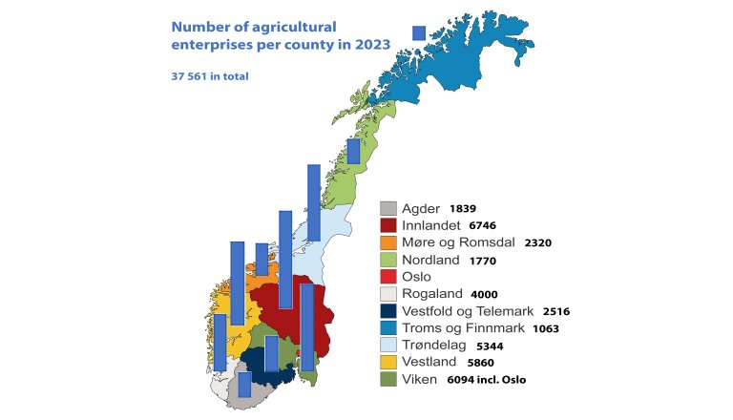
Estimates

Slide 10
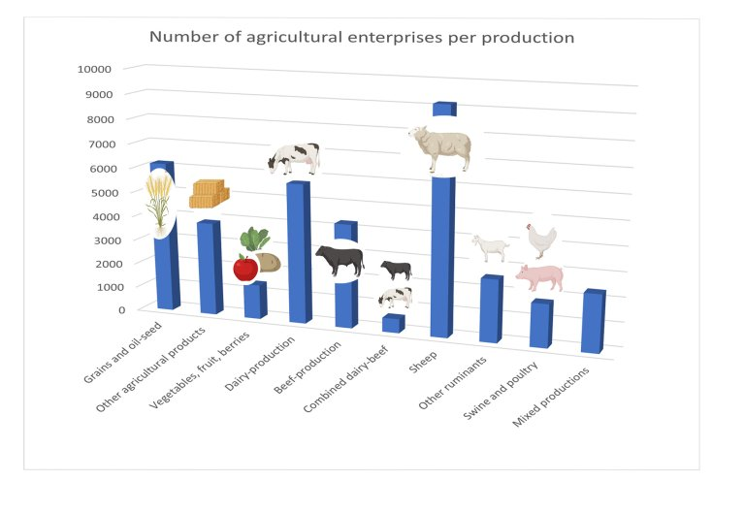
Fact: consumption of meat has doubled in 40 years

Slide 11
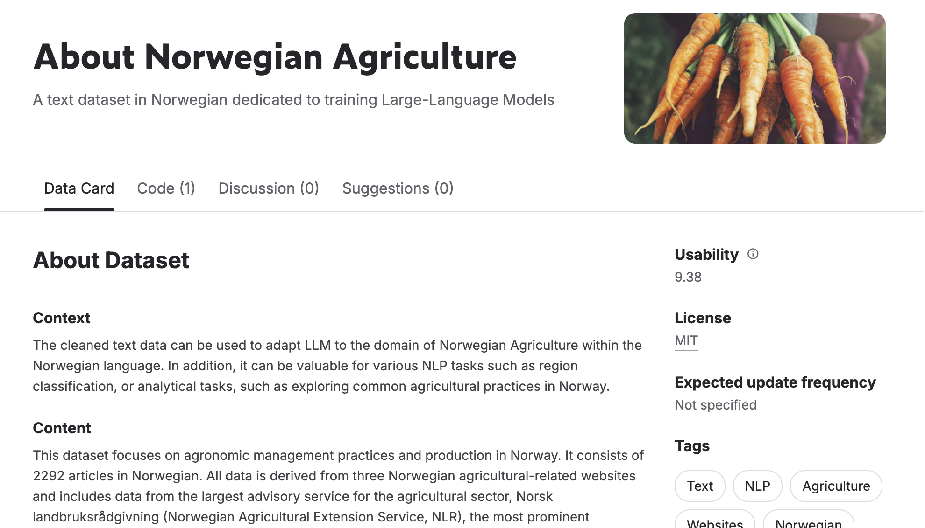
Vision
LLM have succeeded across domains while not being yet enough explored in agriculture.
Our approach is conceptually new and the research can contribute to general knowledge.

